Slide 1

Java for Beginners
Level 2
Mr. Teasdale

Slide 2
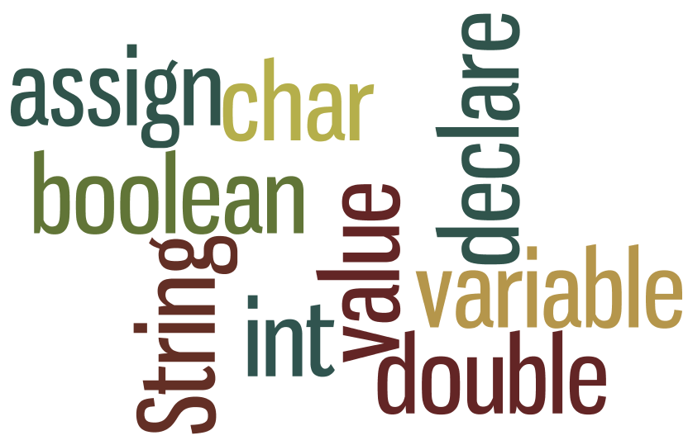
What do you learn last time?
Wordle.org

Slide 3
Levels of Java coding
1: Syntax, laws, variables, output
2: Input, calculations, String manipulation
3: Selection (IF-ELSE)
4: Iteration/Loops (FOR/WHILE)
5: Complex algorithms
6: Arrays
7: File management
8: Methods
9: Objects and classes
10: Graphical user interface elements

Slide 4

5 types of variables
double
boolean
int
char
String

Slide 5

Combining values and variables
int num1 = 5;
int num2 = 10;
System.out.println(num1+num2);
System.out.println(num1+” + ”+num2);
Output
15
5 + 10

Slide 6

Input
From keyboard?
From mouse?
From microphone?
From scanner?
Links to 2.1.2 (Hardware)

Slide 7
Four and ½ steps to keyboard input
Import java.util.* BEFORE main()
Declare a Scanner
Declare a String variable to catch input
Use the Scanner to assign input from keyboard to variable
Convert to int/char/double (if necessary)
import
Scanner
(String) variable
readLine()

Slide 8
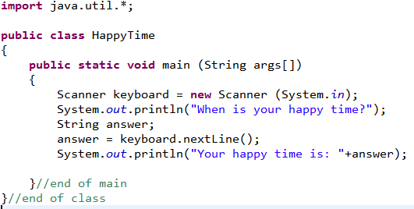
Keyboard input

Slide 9
Important notes:
Input is best received as a String
We use:
String anything = kb.nextLine();
“Green cow”
anything

Slide 10
Converting String to int
To convert String to int, we use a function called Integer.parseInt( );
Example:
String snumber = kb.nextLine();
int num = Integer.parseInt(snumber);
“123”
123
snumber
num

Slide 11
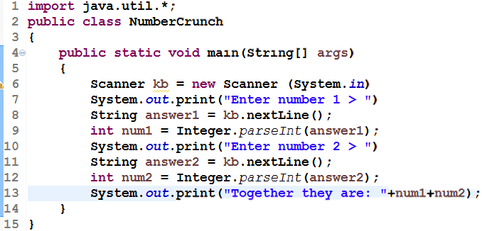
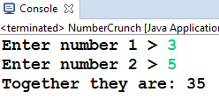
Output

Slide 12
Converting String to double
To convert String to double, we use a function called Double.parseDouble( );
Example:
String snumber = kb.nextLine();
double price = Double.parseDouble(snumber);
“2.95”
2.95
snumber
price

Slide 13
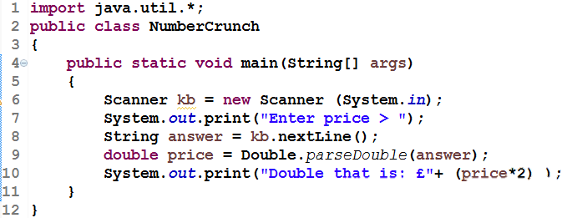
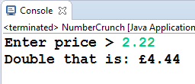
Output

Slide 14
Calculations in Java
Operator | Function | Example | Result
+ | Add | int i = 10 + 2; | 12
- | Subtract | int j = i – 3; | 9
/ | Divide | double k = j / 3; | 3.00
* | Multiply | int product = i * j; | 108
++ | Add 1 | i++; | 13
-- | Subtract 1 | j--; | 8
% | Modulus | int m = 12 % 5; | 2

Slide 15

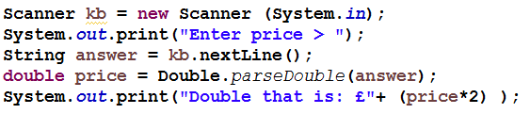
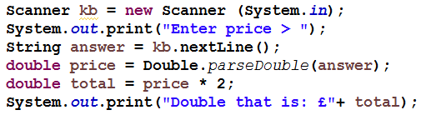
Good practice
Don’t do calculations and output in the same line:
Work out the answer first
THEN display the answer

Slide 16
What students struggle with
int x = 1;
int y = 3;
x = 3;
int total = x + y; Answer: 6
int h = 4;
h++; Answer: 5
int k = 7;
k = k + 2; Answer: 9

Slide 17
More about Strings
String device = “radio”;
r | a | d | i | o
0 | 1 | 2 | 3 | 4
To get a specific character from a String, we use the .charAt( ) function
char letter = device.charAt(2);
“radio”
‘d’
device
letter

Slide 18
String methods
There are many functions we can use to manipulate Strings. They are called the ‘String methods’
Method | Function | Example
.charAt(x) | returns the char from a specified index | String colour = “blue”; char letter = colour.charAt(0);
.toUpperCase() | returns the String in UPPER CASE | String name = “bob”; bob = bob.toUpperCase();
.toLowerCase() | returns the String in lower case | String pet = “DOG”; pet = pet.toLowerCase();
.subString(x,y) | returns String portion between two indexes | String s = “I love hats”; String snip = s.substring(2,6);
.length() | returns how many characters there are in a String | String h = “radar”; int size = h.length();

